Slide 1
GPSC_LIM food web
Part 1: data collection

Slide 2
Available data
GC1
GS1
autumn
spring
summer
complement
Cruise | NOR_T004 | OR1_1096 | OR1_1099 | OR1_1102 | OR1_1114 | OR1_1126 | OR1_1128 | OR1_1132 | OR1_1151 | OR1_1190 | OR1_1219 | OR1_1242
Date | 2020/11 | 2014/11 | 2015/03 | 2015/04 | 2015/08 | 2015/11 | 2016/02 | 2016/03 | 2016/10 | 2018/03-4 | 2019/03-4 | 2019/10
Detritus | √ | √ | √ | √ | √ | √ | √ |  | √ | √ | √ | √
Bacteria |  |  |  |  |  |  |  |  |  | √
Meio |  |  |  |  | √ | √ | √
Macro |  | √ | √ | √ | √ | √ | √ |  | √ | √
TOU | √ |  |  |  |  |  | √ |  | √ | √ | √ | √
DOU | √ |  |  |  |  | √ | √ |  | √ | √ | √ | √
CTD | √ | √ | √ | √ | √ | √ | √ |  | √ | √ | √ | √
Detritus |  | √ | √ | √ | √ | √ |  |  | √ | √ | √ | √
Bacteria |  |  |  |  |  |  |  |  |  | √
Meio |  |  |  |  | √ | √ |  | √
Macro |  | √ | √ | √ | √ | √ |  | √ | √ | √
TOU |  |  |  |  | √ | √ |  |  |  | √ | √ | √
DOU |  |  |  |  |  | √ |  |  | √ | √ | √ | √
CTD |  | √ | √ | √ | √ | √ |  | √ | √ | √ | √ | √

Slide 3
CTD
Data integrated process:
Plot water profiling
filter only descent (the “down cast”) data: usually more accurate
Set negtive transmissometer to zero
For each single data, take the average temperature, sigma_theta and density
Bottom water
Temperature: average the deepest 3 data
Calculate the temperature limitation factor(Tlim): use in LIM model
Tlim=Q10* exp((T-20)/10); with Q10=2
Result:
Bottom water temperature:
Q10: defines the temperature coefficient
Most biological systems: Q10 between 2-3
Variations between during different developmental stages and between species
Q10=2: the rate of the reaction doubles for each 10°C rise in T
Q10=3: the reaction rate triple with each 10°C rise in T
Station | Bottom water temperature(°C) | Tlim
GC1 | 13.54 | 1.05
GS1 | 13.90 | 1.09

Slide 4
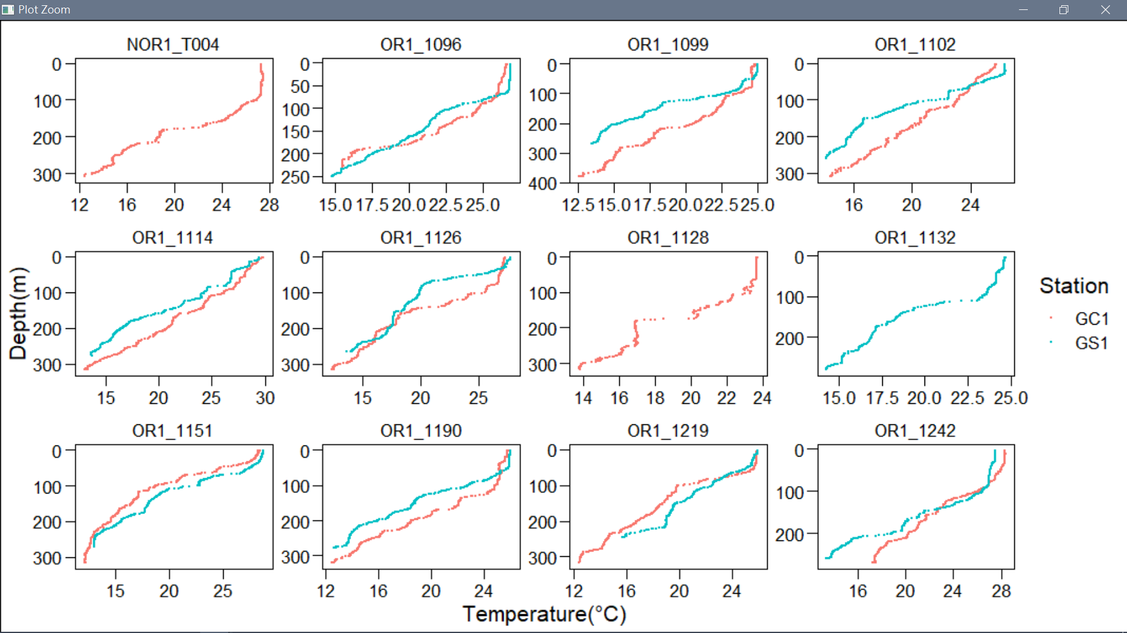
CTD
B. Result:
2. Water profiling: Temperature v.s. Pressure (depth)
autumn
spring
summer

Slide 5
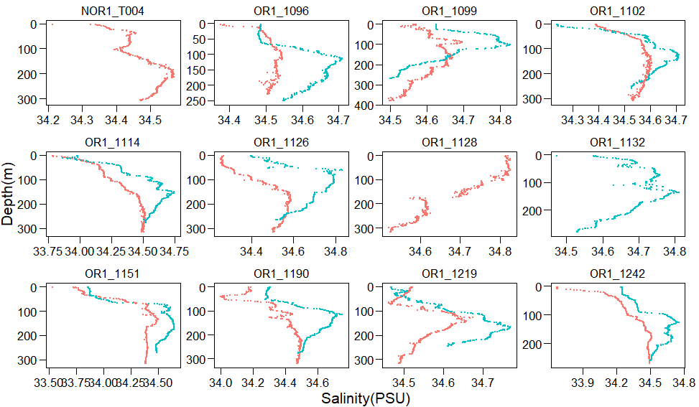
CTD
B. Result:
3. Water profiling: Salinity v.s. Pressure (depth)
autumn
spring
summer

Slide 6
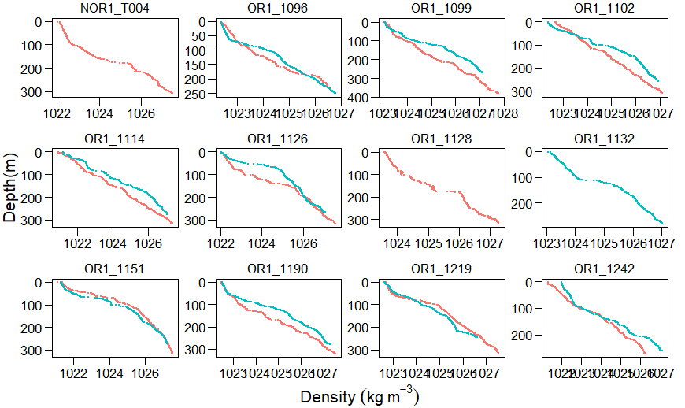
CTD
B. Result:
3. Water profiling: Density v.s. Pressure (depth)
autumn
spring
summer

Slide 7
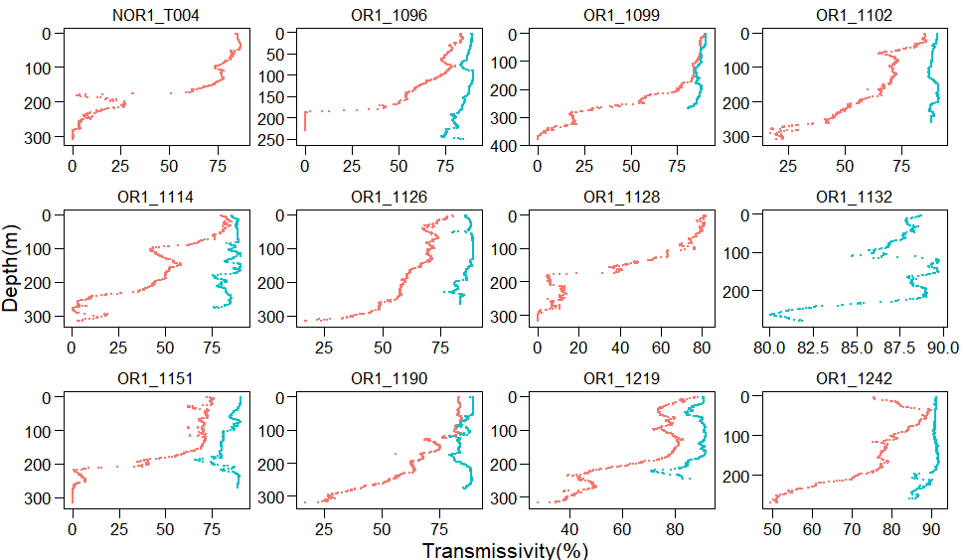
CTD
B. Result:
3. Water profiling: Transmissivity v.s. Pressure (depth)
autumn
spring
summer

Slide 8
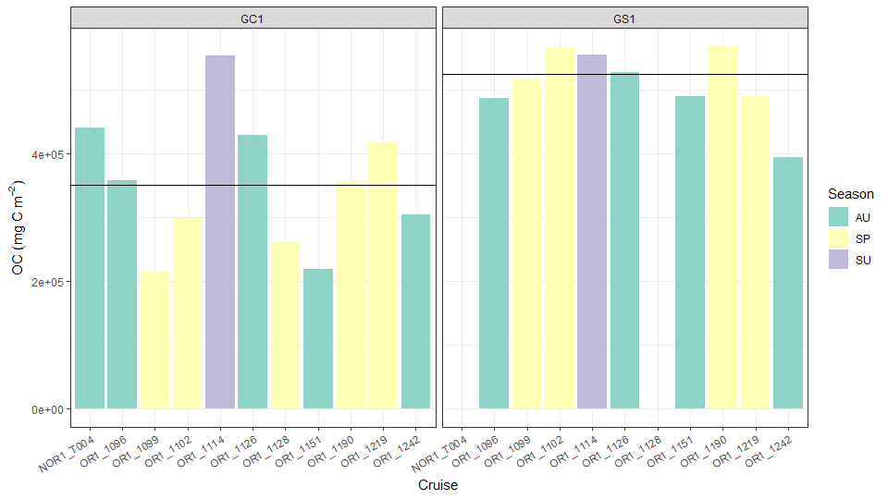
Steps:
Calculation: volume (m3)= core area (m2) * 0.1 (m)
Volume(m3) * density (g/cm3) * TOC(%) -> mg C
2 Section types:
0-1 cm only -> directly *10
(0-1)+(1-2)+(2-3)+(3-4)+(4-5)+5*(9-10)
Define season
A. Sediment OC
Summary
No obvious seasonality
Keep all data and take average
GS1 > GC1 in 1.5 times

Slide 9
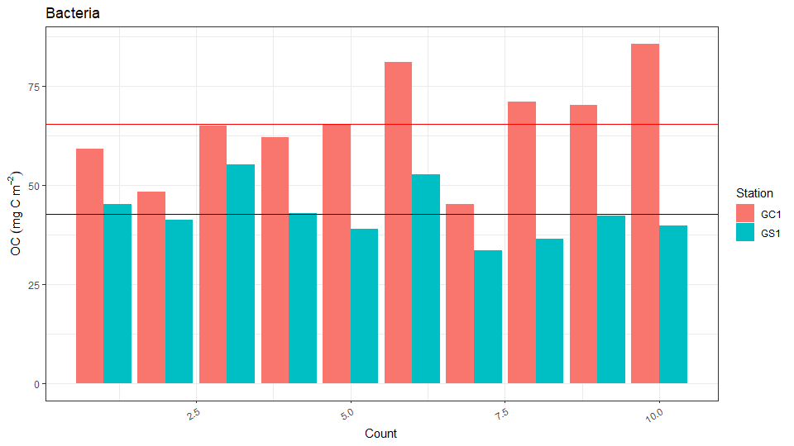
B. Bacteria
Steps:
# bac / ml (cm3)*(10)cm -> mgC/m2
Result:
Summary
Variation in every count: GC1>GS1
GC1 > GS1 in 1.5 times

Slide 10
C. Macrofauna
Steps to calculate biomass OC
Assume all fauna within 10cm of sediment have been already included
For the common taxon (e.g. Polychaeta, Nematoda)
use conversion factor(C) to calculate volume: V=L*W^2*C
Different body shape: different ways to calculate volume
Cone: V=L*(W/2)^2*pi/3
Cylinder: V= L*(W/2)^2*pi
Ellipsoid: V= L*(W/2)^2*pi*4/3
DryW(mg)=volume(mm3)*1.13 (g/cm3=mg/mm3)
OC=DryW*0.043 (fraction)
OC/core area -> mgC/m2
Carefully remove the outlier (the too big ones)
Steps to find community structure (abundance)

Slide 11
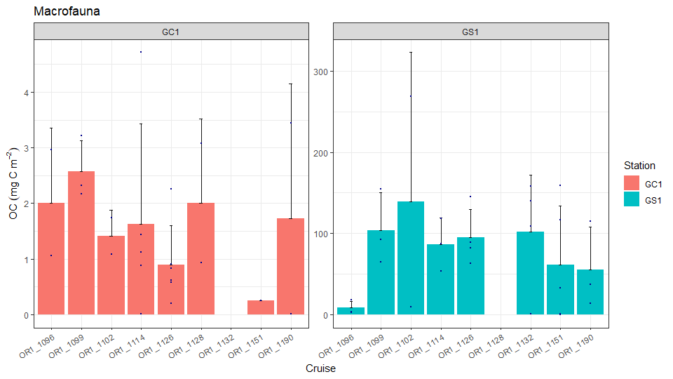
C. Macrofauna
Summary
Variation in every tube sample even in the same cruise
GS1 >> GC1 in 2 order of magnitude
c) Result for biomassOC:

Slide 12
C. Macrofauna
Statistics: If there's biomass difference exist between different seasons in GC1?
H0: mean SP = mean AU = mean SU
HA: at least mean of one season is different from the others
Assumptions for ANOVA
1.randomly sampled and samples are independent
2.samples come from a normally distributed population
Shapiro-Wilk normality test (N<50)
p-value = 0.05805 (>0.05)
samples are normally distributed
3. Samples are with unknown but equal variances
F test
AU vs SP: p-value = 0.5394 (>0.05)
AU vs SU: p-value = 0.1052 (>0.05)
SP vs SU: p-value = 0.2724 (>0.05)
there is no statistically difference between the variance of seasons
ANOVA
Pr(>F)=0.303(>0.05)
cannot reject H0 and conclude that there is no statistically difference between the mean of seasons
Nonparametric test (if samples are not normally distributed
Kruskal Wallis Test
p-value = 0.1605 (>0.05)
cannot reject H0 and conclude that there is no statistically difference between the mean of seasons

Slide 13
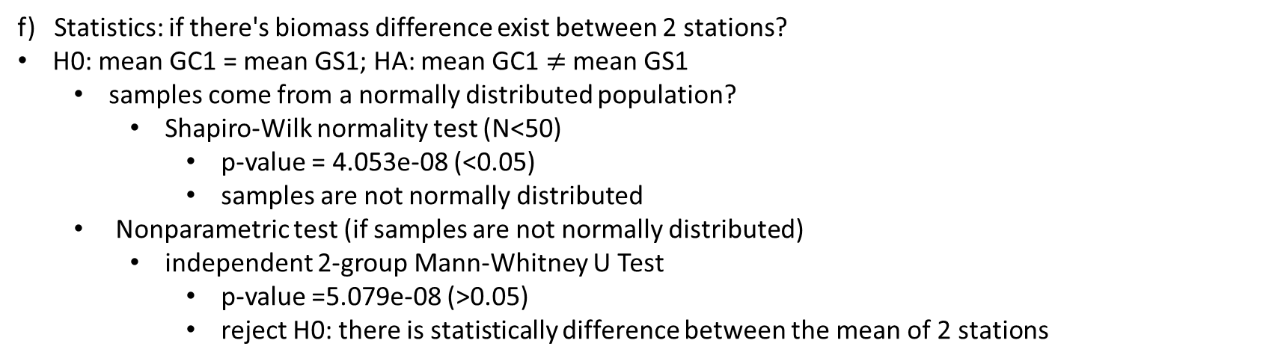
C. Macrofauna
e) Statistics: If there‘s biomass difference exist between different seasons in GS1?
H0: mean of all season are the same (mean SP = mean AU = mean SU)
HA: at least mean of one season is different from the others
Assumptions for ANOVA
randomly sampled and samples are independent
samples come from a normally distributed population
Shapiro-Wilk normality test (N<50)
p-value = 0.03998 (<0.05)
samples are not normally distributed
Nonparametric test (if samples are not normally distributed )
Kruskal Wallis Test
p-value =0.4471 (>0.05)
cannot reject H0 and conclude that there is no statistically difference between the mean of seasons
f) Statistics: if there's biomass difference exist between 2 stations?
H0: mean GC1 = mean GS1; HA: mean GC1 $≠$ mean GS1
samples come from a normally distributed population?
Shapiro-Wilk normality test (N<50)
p-value = 4.053e-08 (<0.05)
samples are not normally distributed
Nonparametric test (if samples are not normally distributed)
independent 2-group Mann-Whitney U Test
p-value =5.079e-08 (>0.05)
reject H0: there is statistically difference between the mean of 2 stations

Slide 14
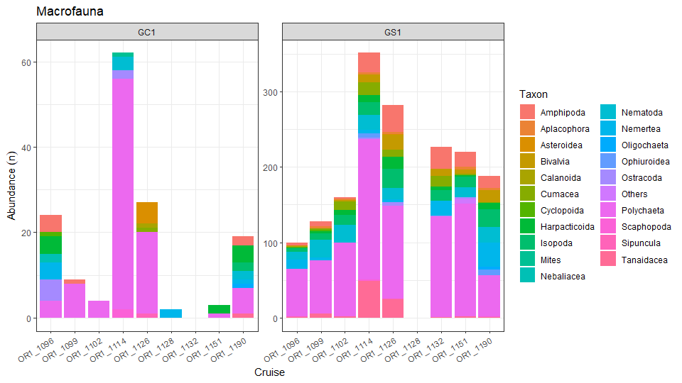
C. Macrofauna
Summary
Higher diversity in GS1
Average abundance 11 times higher in GS1
c) Result for abundance:

Slide 15
D. Meiofauna
Steps:
Assume all fauna within 5cm of sediment have been already included
For the common taxon (e.g. Nematoda, Harpacticoida)
use conversion factor(C) to calculate volume: V=L*W^2*C
DryW(mg)=volume(mm3)*1.13 (g/cm3=mg/mm3)
OC=DryW*0.012 (fraction)
OC/syringe area -> mgC/m2
! Only 100 nematodes were measured the length and width for each subcore
-> calculate the mean OC of 100 nematodes
-> mean * the total amount of nematodes = accurate biomass
Steps to find community structure (abundance)
With nematodes
Without nematodes

Slide 16
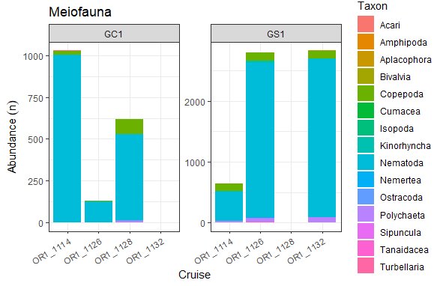
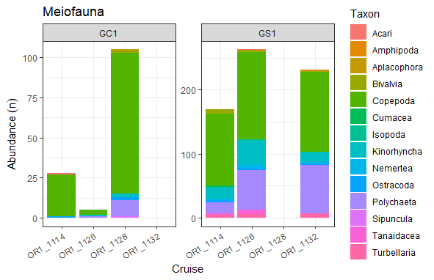
D. Meiofauna
Summary
Higher diversity in GS1
Average abundance 3.5 times higher in GS1
c1) Result for abundance (w/ Nematoda):
c2) Result for abundance (w/o Nematoda):

Slide 17
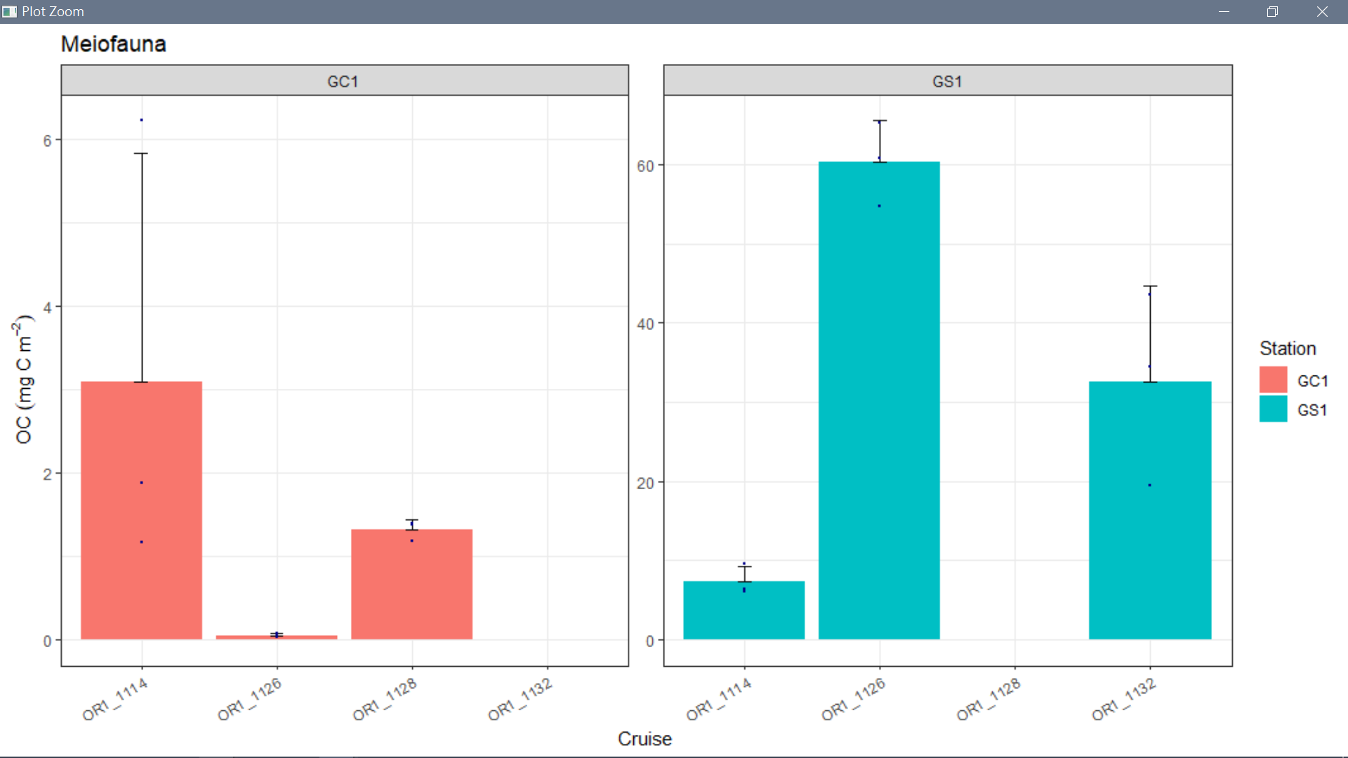
Summary
GS1 > GC1 in 1 order of magnitude
Low biomass for GC1 in OR1_1126 (both macro and meio)
Low meio biomass for GS1 in OR1_1114 (only meio)
Seasonality?
Not because of typhoon: 2015 typhoon seasons were relative inactive
D. Meiofauna
c) Result for biomass:
2015/08
2015/11
2016/02
2016/03

Slide 18
D. Meiofauna
d) Statistics: If there‘s biomass difference exist between different seasons in GS1?
H0: mean of all season are the same (mean SP = mean AU = mean SU)
HA: at least mean of one season is different from the others
Assumptions for ANOVA
randomly sampled and samples are independent
samples come from a normally distributed population
Shapiro-Wilk normality test (N<50)
p-value =0.2007 (>0.05)
samples are normally distributed
3. Samples are with unknown but equal variances
F test
AU vs SP: p-value = 0.3183 (>0.05)
AU vs SU: p-value = 0.2387 (>0.05)
SP vs SU: p-value = 0.05003 (>0.05)
there is no statistically difference between the variance of seasons
ANOVA
Pr(>F)=0.000488(<0.05)
reject H0: there is statistically difference between the mean of seasons

Slide 19
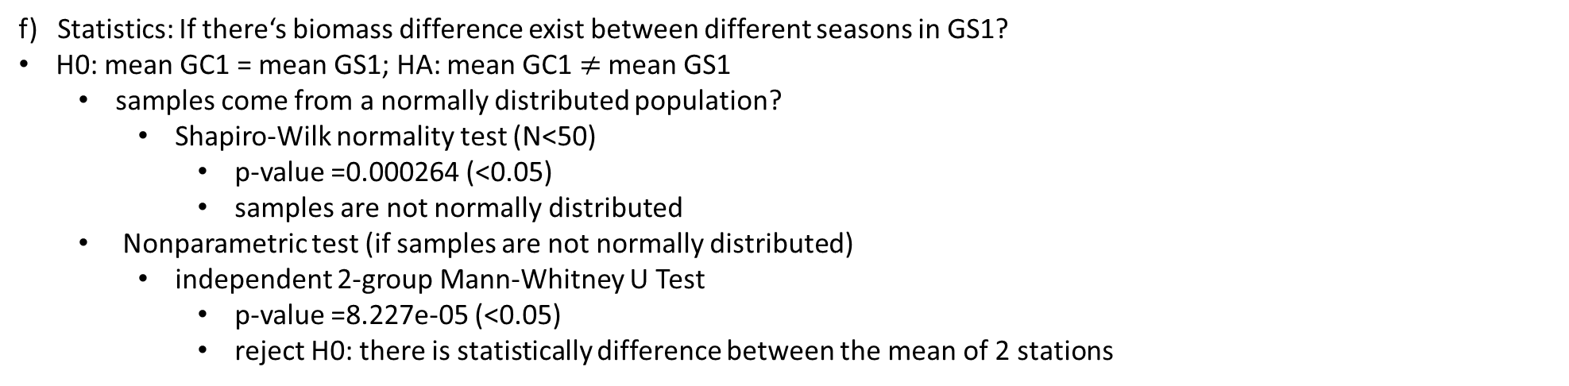
e) Statistics: If there‘s biomass difference exist between different seasons in GC1?
H0: mean of all season are the same (mean SP = mean AU = mean SU)
HA: at least mean of one season is different from the others
Assumptions for ANOVA
randomly sampled and samples are independent
samples come from a normally distributed population
Shapiro-Wilk normality test (N<50)
p-value =0.001654 (<0.05)
samples are not normally distributed
Nonparametric test (if samples are not normally distributed )
Kruskal Wallis Test
p-value =0.06081 (>0.05)
cannot reject H0 and conclude that there is no statistically difference between the mean of seasons
D. Meiofauna
f) Statistics: If there‘s biomass difference exist between different seasons in GS1?
H0: mean GC1 = mean GS1; HA: mean GC1 $≠$ mean GS1
samples come from a normally distributed population?
Shapiro-Wilk normality test (N<50)
p-value =0.000264 (<0.05)
samples are not normally distributed
Nonparametric test (if samples are not normally distributed)
independent 2-group Mann-Whitney U Test
p-value =8.227e-05 (<0.05)
reject H0: there is statistically difference between the mean of 2 stations

Slide 20
Size spectrum for macrofauna and meiofauna

Slide 21
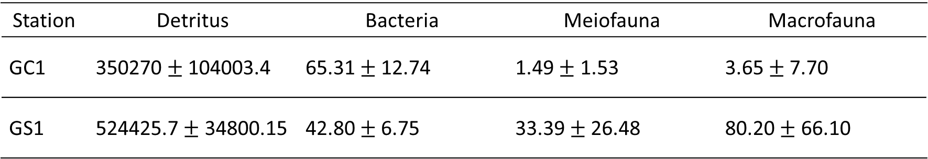
Summary for organic carbon calculation
Unit: mgC/m2
Station | Detritus | Bacteria | Meiofauna | Macrofauna
GC1 | 350270 $±$ 104003.4 | 65.31$±$12.74 | 1.49 $±$ 1.53 | 3.65$±$7.70
GS1 | 524425.7 $±$ 34800.15 | 42.80$±$6.75 | 33.39 $±$26.48 | 80.20 $± \text{66.}\text{10}$

Slide 22
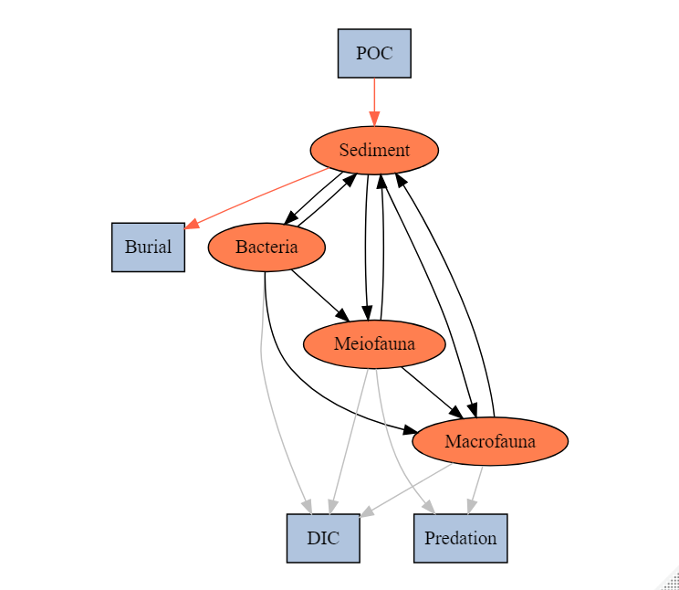
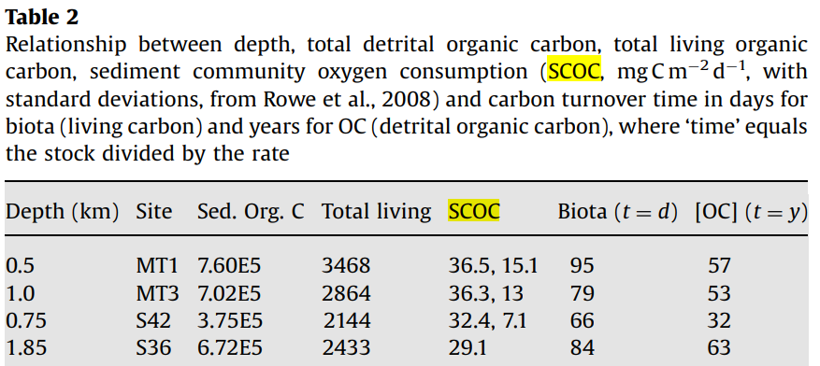
Ex=f
BAC->DIC
MEI->DIC
MAC->DIC
SCOC (TOU)
DOU
BMU
Comparison (Rowe et al. 2008)
MT1: 36.5 mg C/m2/d
MT3: 36.3 mg C/m2/d
TOU:
benthos' respiration and the benthos-mediated oxygen utilization through their activities
DOU:
mainly contributed by aerobic respiration of microorganisms through slow diffusion of oxygen molecules
BMU:
benthos-mediated oxygen utilization, characterizing benthos' contribution to sediment oxygen dynamics

Slide 23
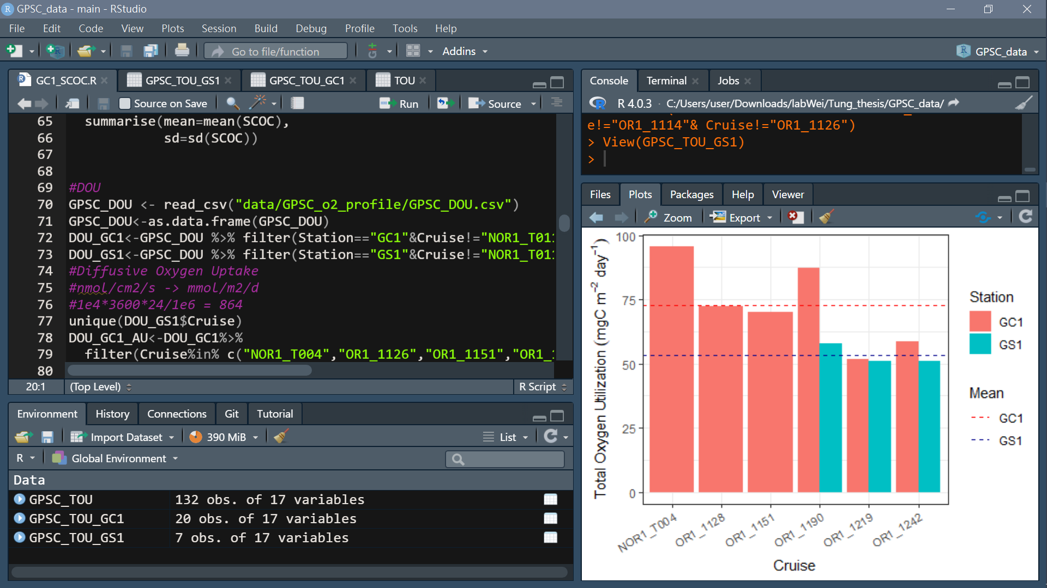
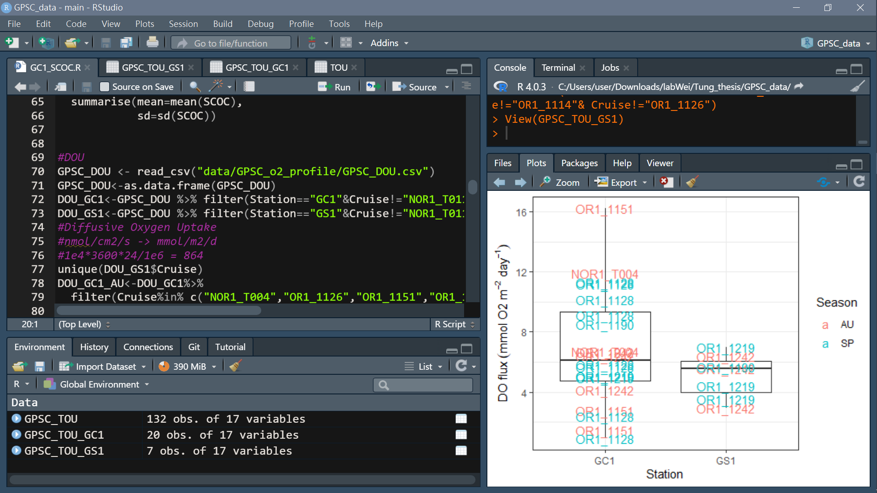
Ex=f
Data collected from ship-board incubation:
DO measured until the concentrations decreased by 15% of the initial concentration
The fluxes of oxygen unit: (mmol/m2/day) (Change in concentration x Volume of overlying water) / (Core area x Time])
mmolO2 -> mgO2: 33.191 mgO2/mmolO2
mgO2 -> mgC: 0.309 mgC/mgO2
SCOC (TOU)
*Remove GS1 of OR1_1114 & OR1_1126 outlier (1 core only and outlier)

Slide 24
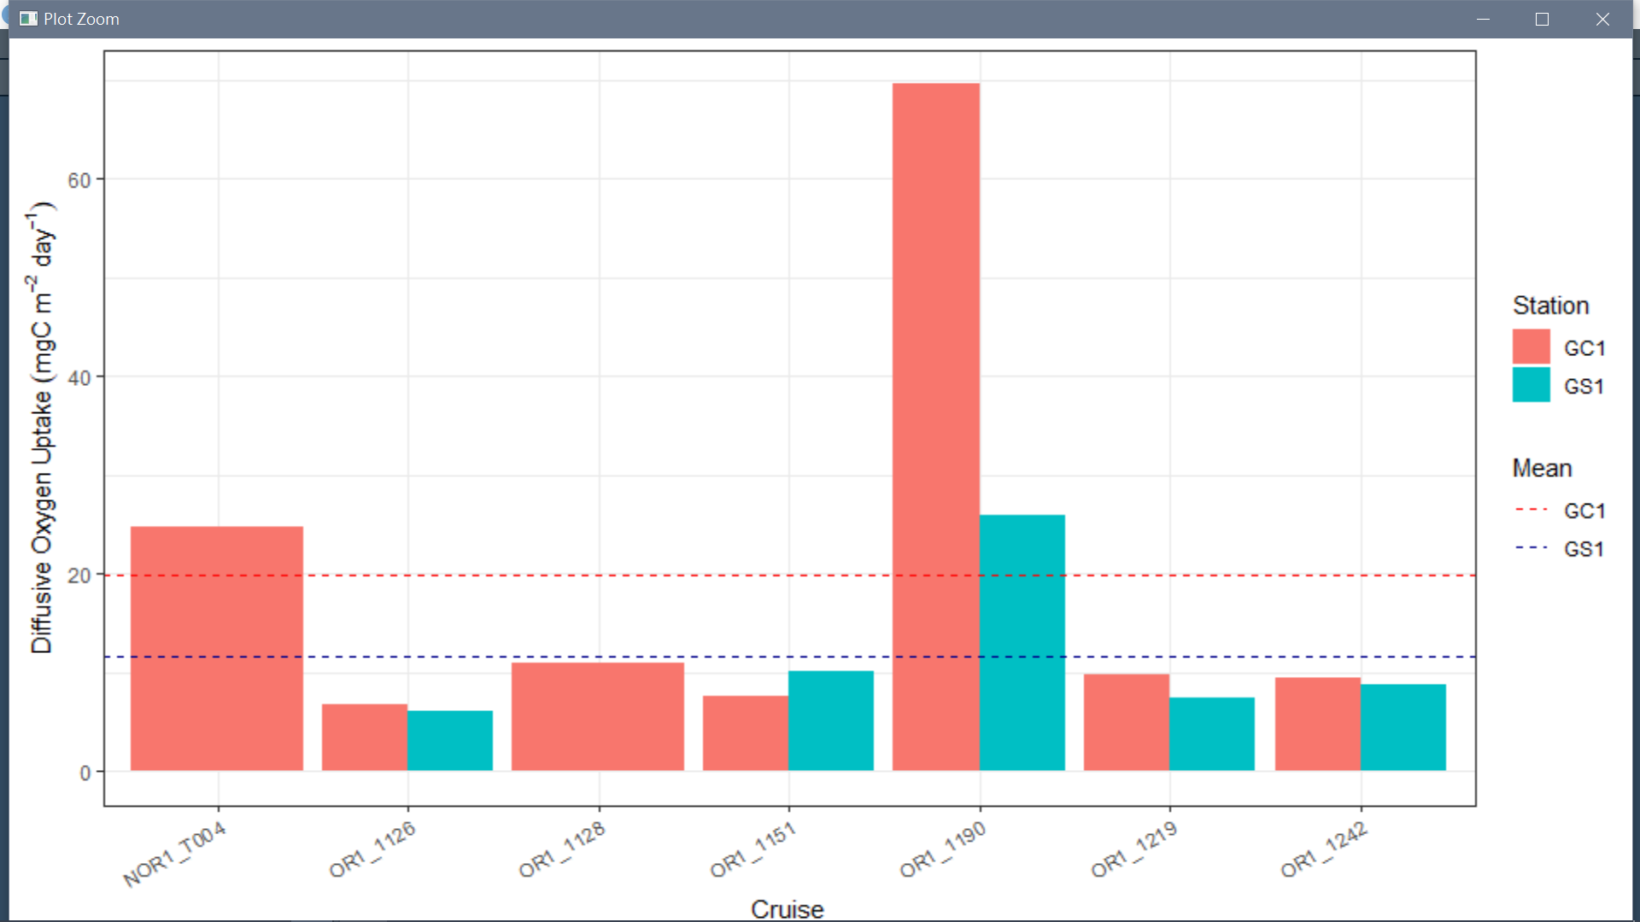
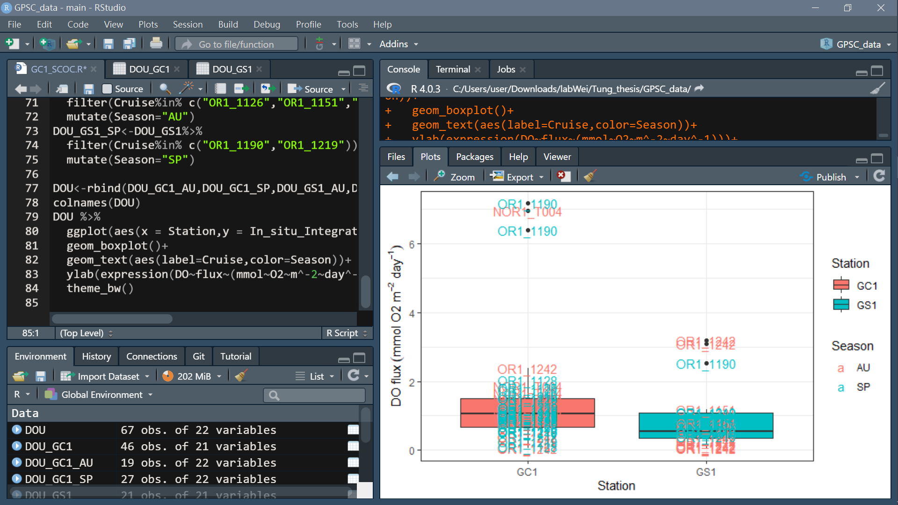
Ex=f
After the shipboard incubation
Unisense® Field Microprofiling System measure the sediment oxygen profile concentrations
DOU

Slide 25
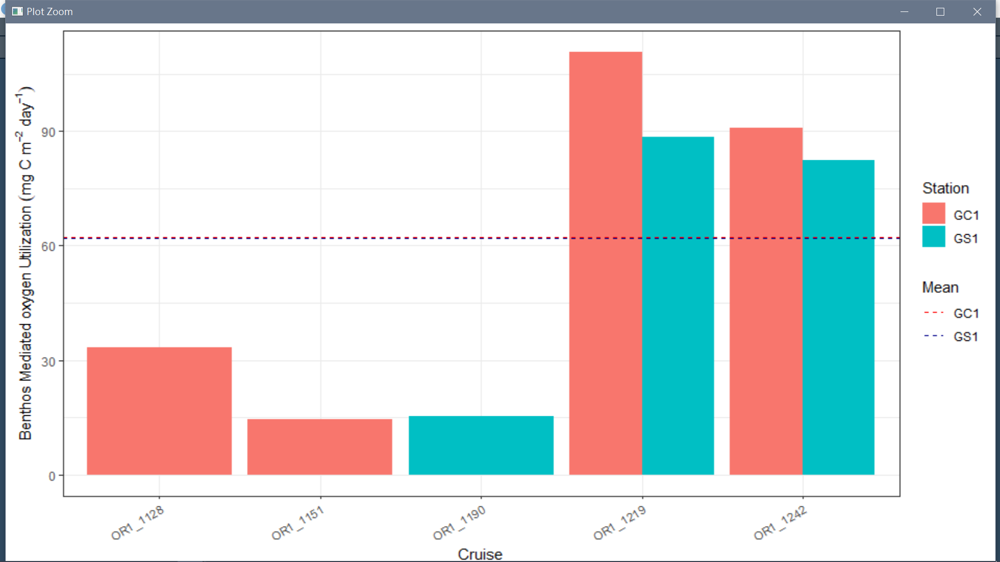
Ex=f
BMU

Slide 26
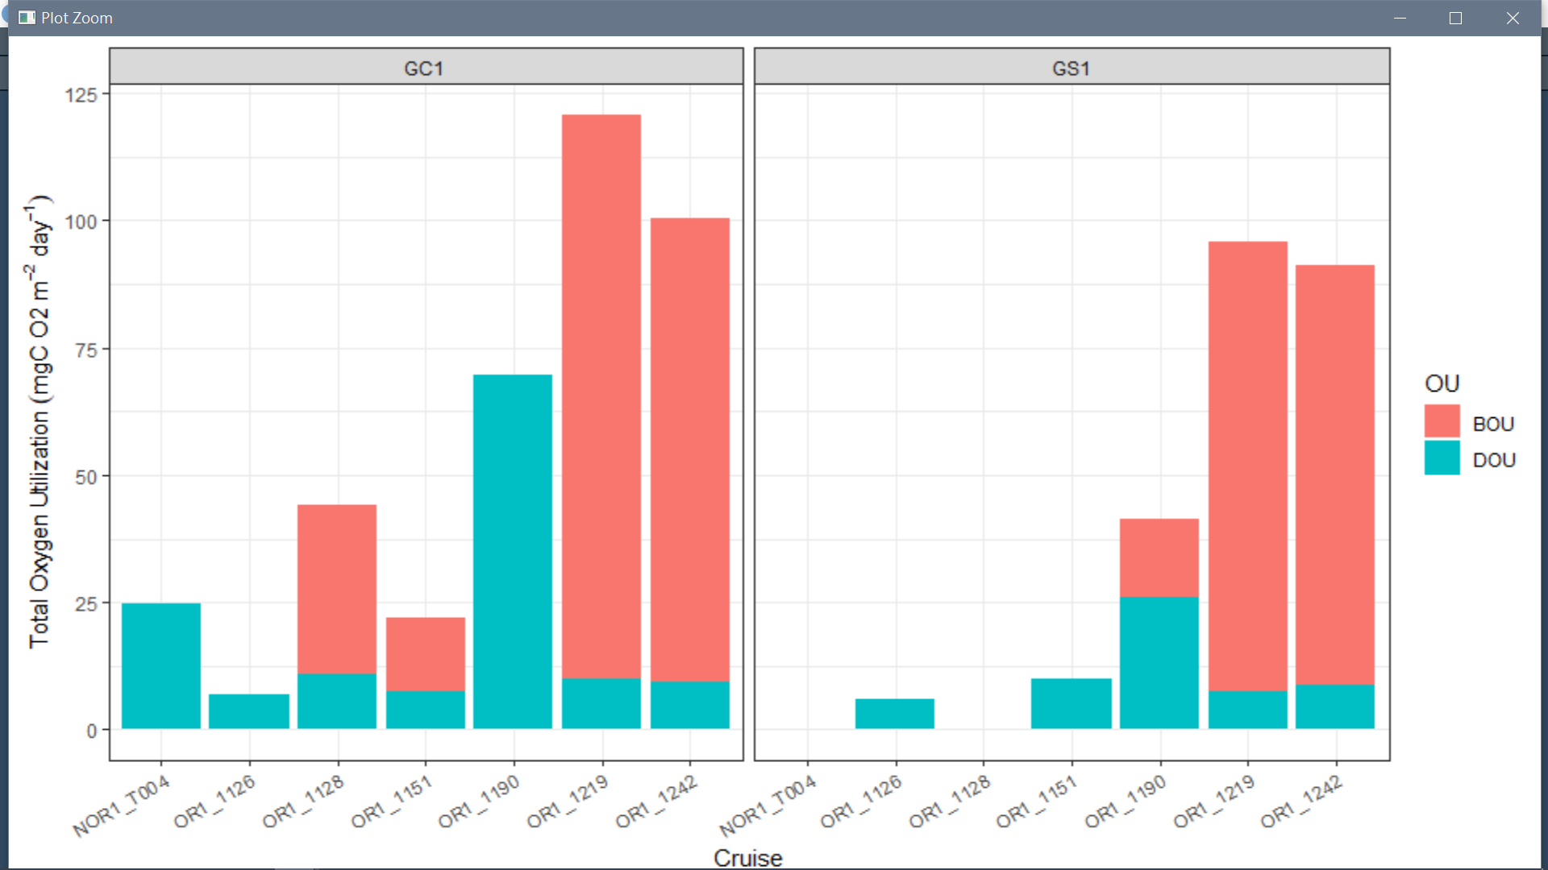
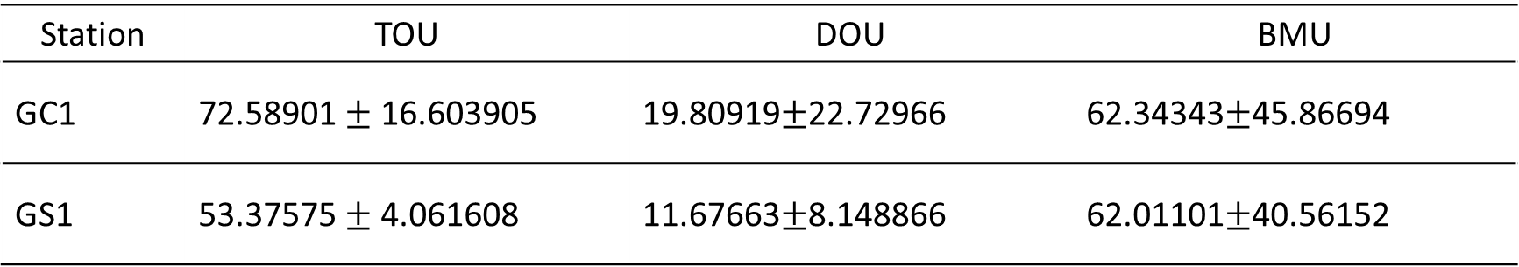
Ex=f
Summary
Unit: mgC/m2/d
Station | TOU | DOU | BMU
GC1 | 72.58901 $±$ 16.603905 | 19.80919$±$22.72966 | 62.34343$±$45.86694
GS1 | 53.37575 $±$ 4.061608 | 11.67663$±$8.148866 | 62.01101$±$40.56152

Slide 27
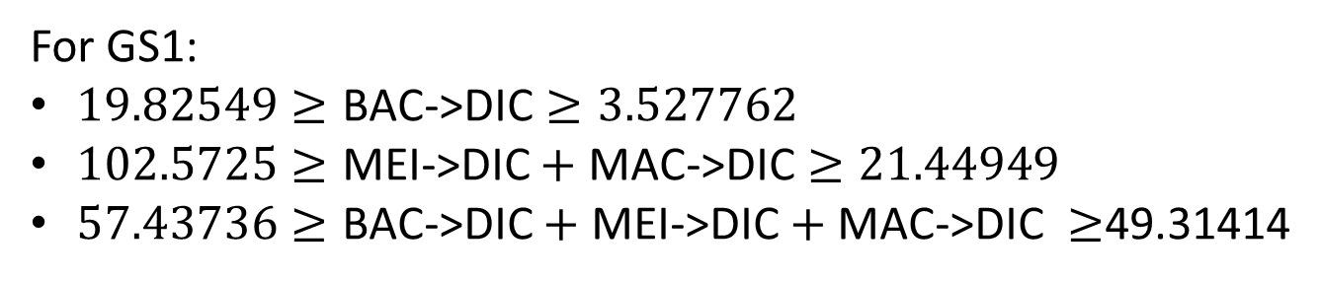
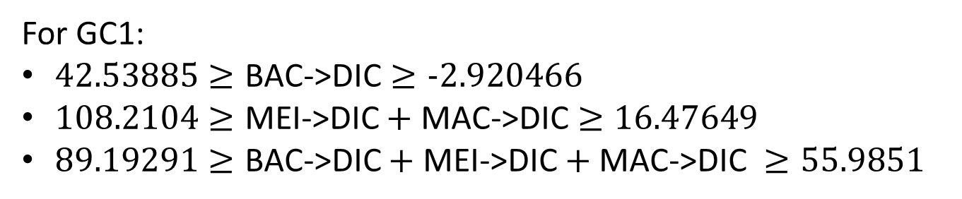
Ex=f
In situ data of Oxygen Utilization
For GC1:
$42.53885≥\text{BAC}\text{−>}\text{DIC}≥−2.920466$
$108.2104≥\text{MEI}\text{−>}\text{DIC}+\text{MAC}\text{−>}\text{DIC}≥16.47649$
$89.19291≥\text{BAC}\text{−>}\text{DIC}+\text{MEI}\text{−>}\text{DIC}+\text{MAC}\text{−>}\text{DIC} ≥55.9851$
For GS1:
$19.82549≥\text{BAC}\text{−>}\text{DIC}≥3.527762$
$102.5725≥\text{MEI}\text{−>}\text{DIC}+\text{MAC}\text{−>}\text{DIC}≥21.44949$
$57.43736≥\text{BAC}\text{−>}\text{DIC}+\text{MEI}\text{−>}\text{DIC}+\text{MAC}\text{−>}\text{DIC} ≥$49.31414
In situ data of Oxygen Utilization

Slide 28
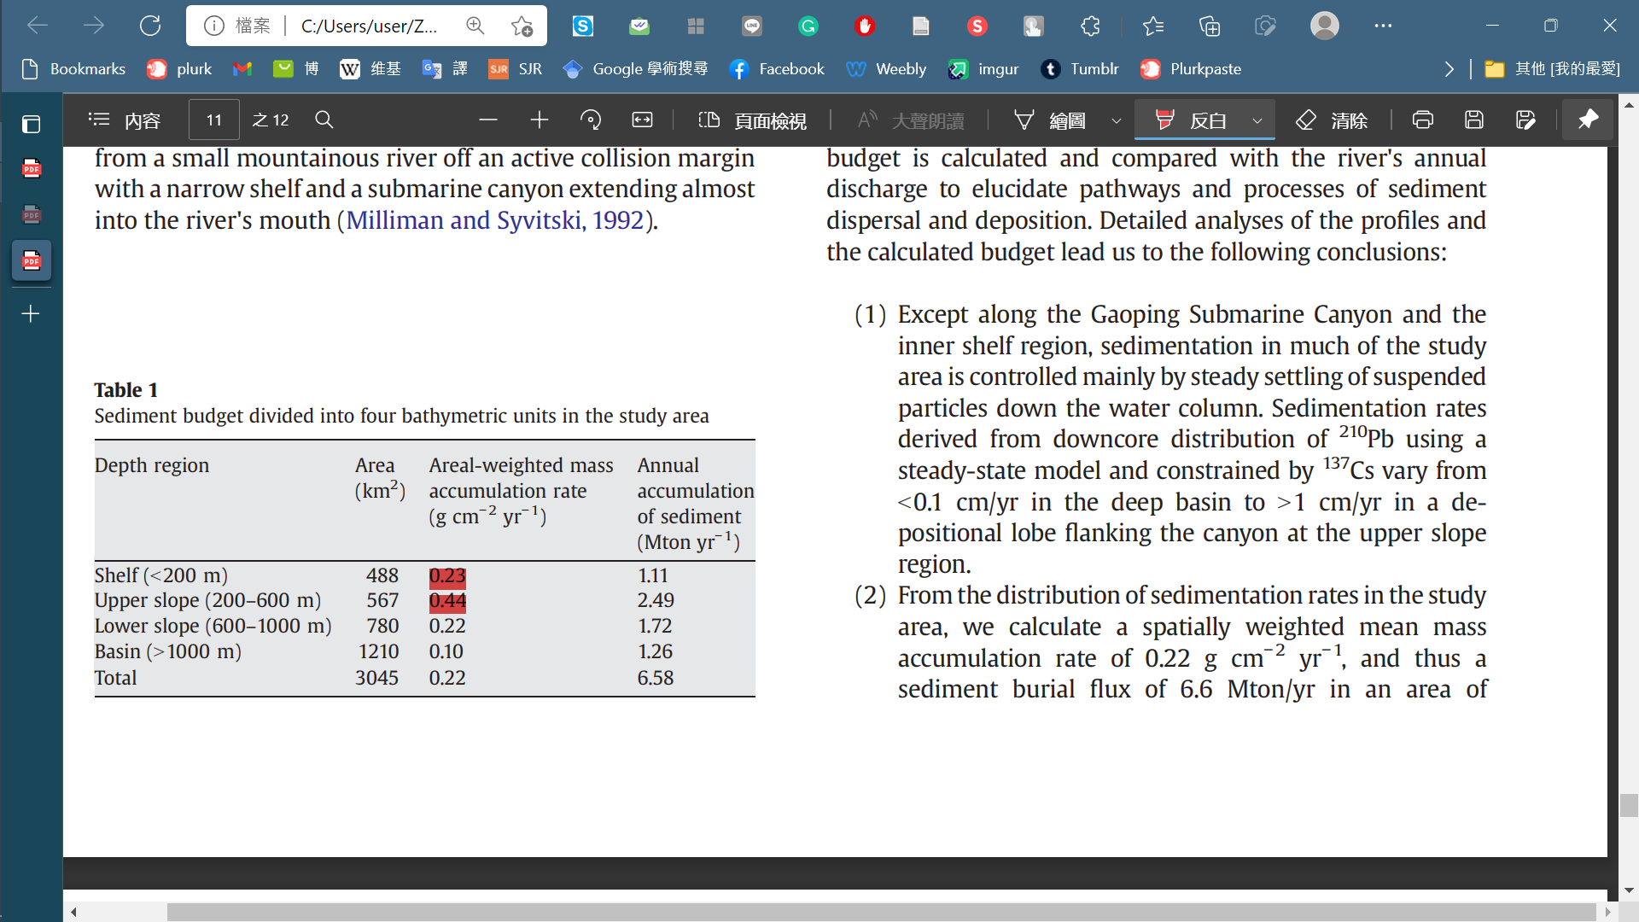
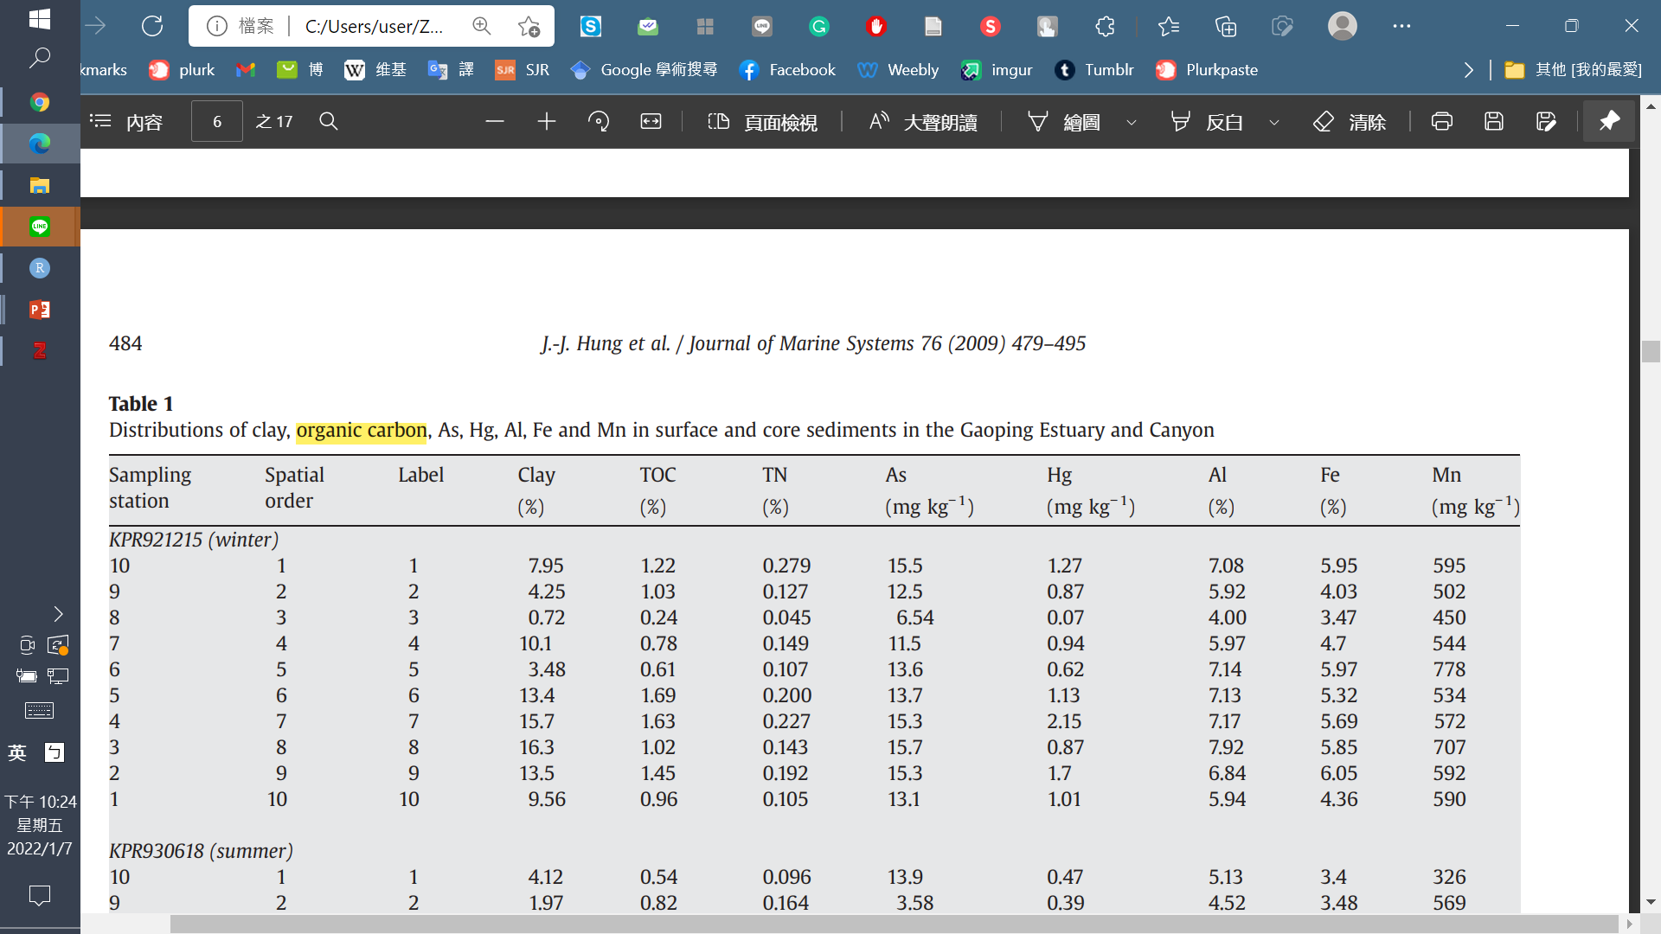
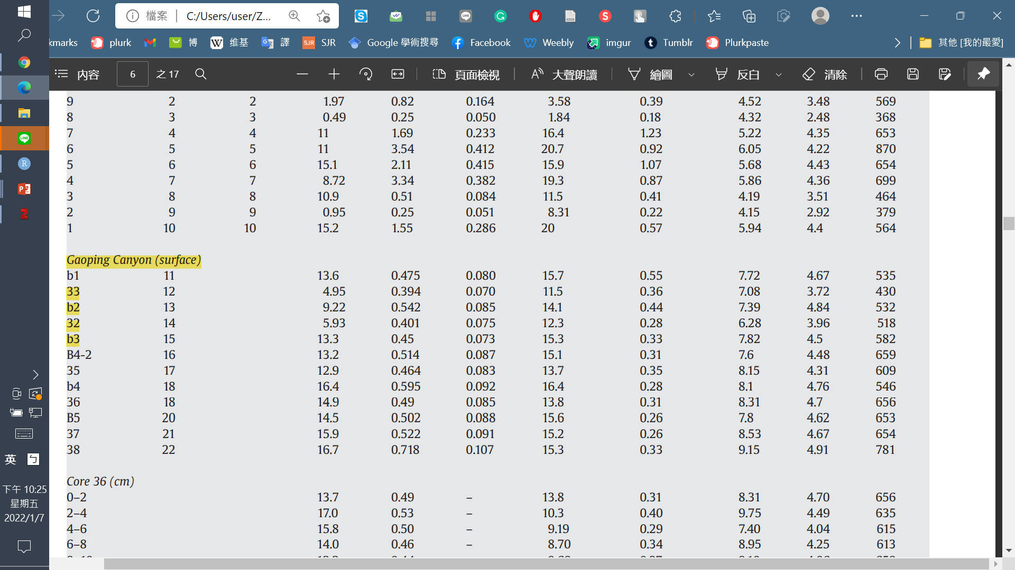
Ex=f
Huh et al (2009)
POC->SED
12054.79* 0.44675 % = 53.85 mg/m2/d
0.44 g/cm2/yr -> 12054.79 mg/m2/d
The head of GPSC is deeply incised into the continental shelf (i.e.,vertical relief>400 m)
Hung et al (2009)
Comparison:
MT1: 77.7 mgC/m2/d (Rowe et al. 2008)
Nazare canyon (upper): Carbon deposition from water column/ MacSF: 11.52-112.8 mgC/m2/d(van Oevelen et al. 2011)
0.44675%

Slide 29
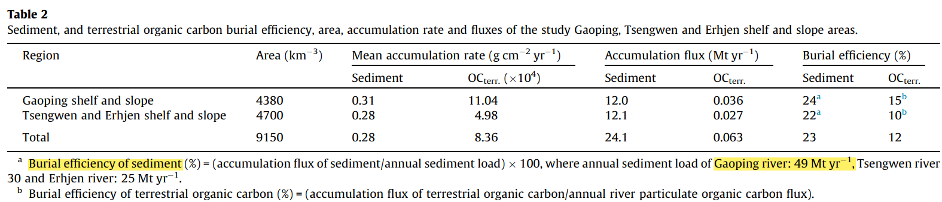
Ex=f
SED->EXP_S=0.24*POC->SED
Hsu et al. (2014)

Slide 30
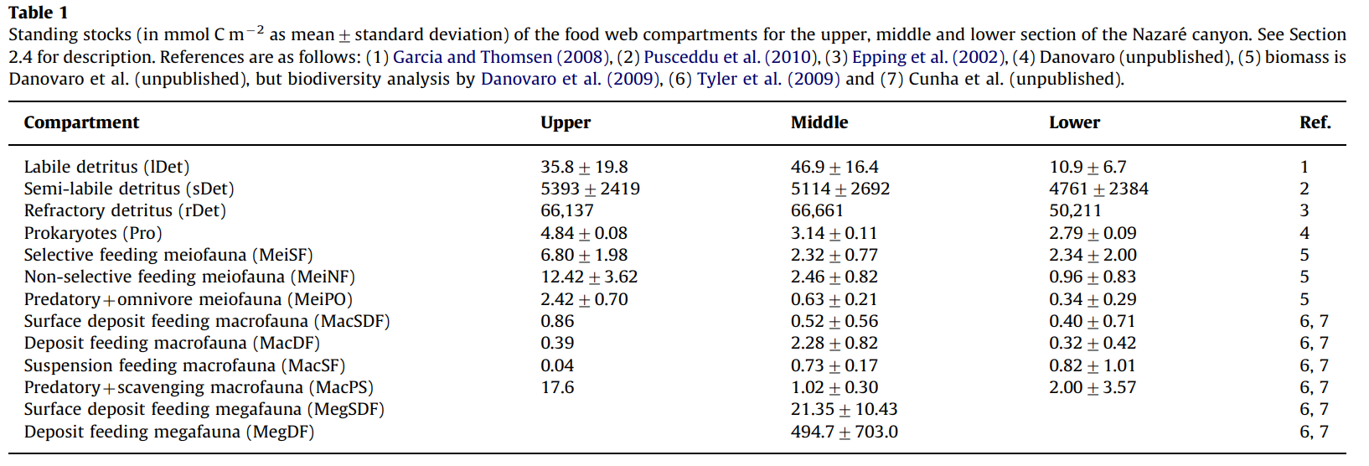
Comparison: Data from van Oevelen et al.(2011) in Nazare canyon
1mol C =12g C
mg C/m2
429.6
64716
793644
58.08
81.6
149.04
29.04
10.32
4.68
0.48
211.2
Compartment | Standing stock (mgC m⁻²)
Detritus | 858,789.6
Bacteria | 58.08
Meiofauna | 259.68
Macrofauna | 226.68

Slide 31
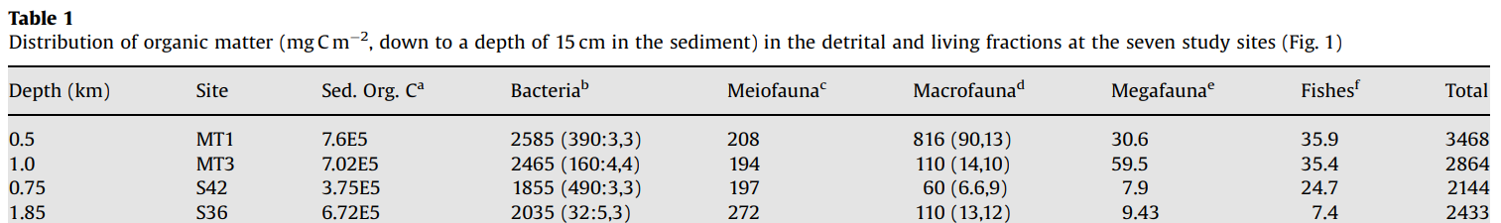
Comparison: Data from Rowe et al. (2008) in Gulf of Mexico
MT1: Mississippi canyon head
MT3: upper continental slope in the Mississippi Canyon
S36 : deep continental slope in the DeSoto Canyon
MT1
MT3
Compartment | Standing stock (mgC m⁻²)
Detritus | 760000
Bacteria | 2585
Meiofauna | 208
Macrofauna | 816
Compartment | Standing stock (mgC m⁻²)
Detritus | 702000
Bacteria | 2465
Meiofauna | 194
Macrofauna | 110

Slide 32
Compartment | Standing stock (mgC m⁻²)
Detritus | 2504.94
Bacteria | 4.62
Meiofauna | 0.69
Macrofauna | 3.65
Problem 1
Sampling season
Cruise | OR1_1096 | OR1_1099 | OR1_1102 | OR1_1114 | OR1_1126 | OR1_1128 | OR1_1151 | OR1_1190
Date | 2014/11 | 2015/03 | 2015/04 | 2015/08 | 2015/11 | 2016/02 | 2016/10 | 2018/03-04
Detritus | √ | √ | √ | √ | √ | √ | √ | √
Bacteria |  |  |  |  |  |  |  | √
Meiofauna |  |  |  | √ | √ | √
Macrofauna | √ | √ | √ | √ | √ | √ | √ | √

Slide 33
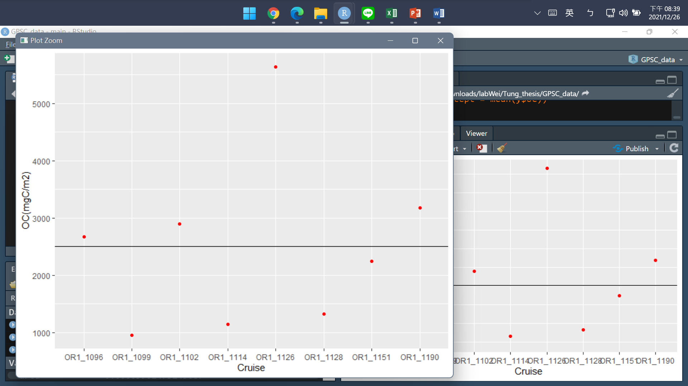
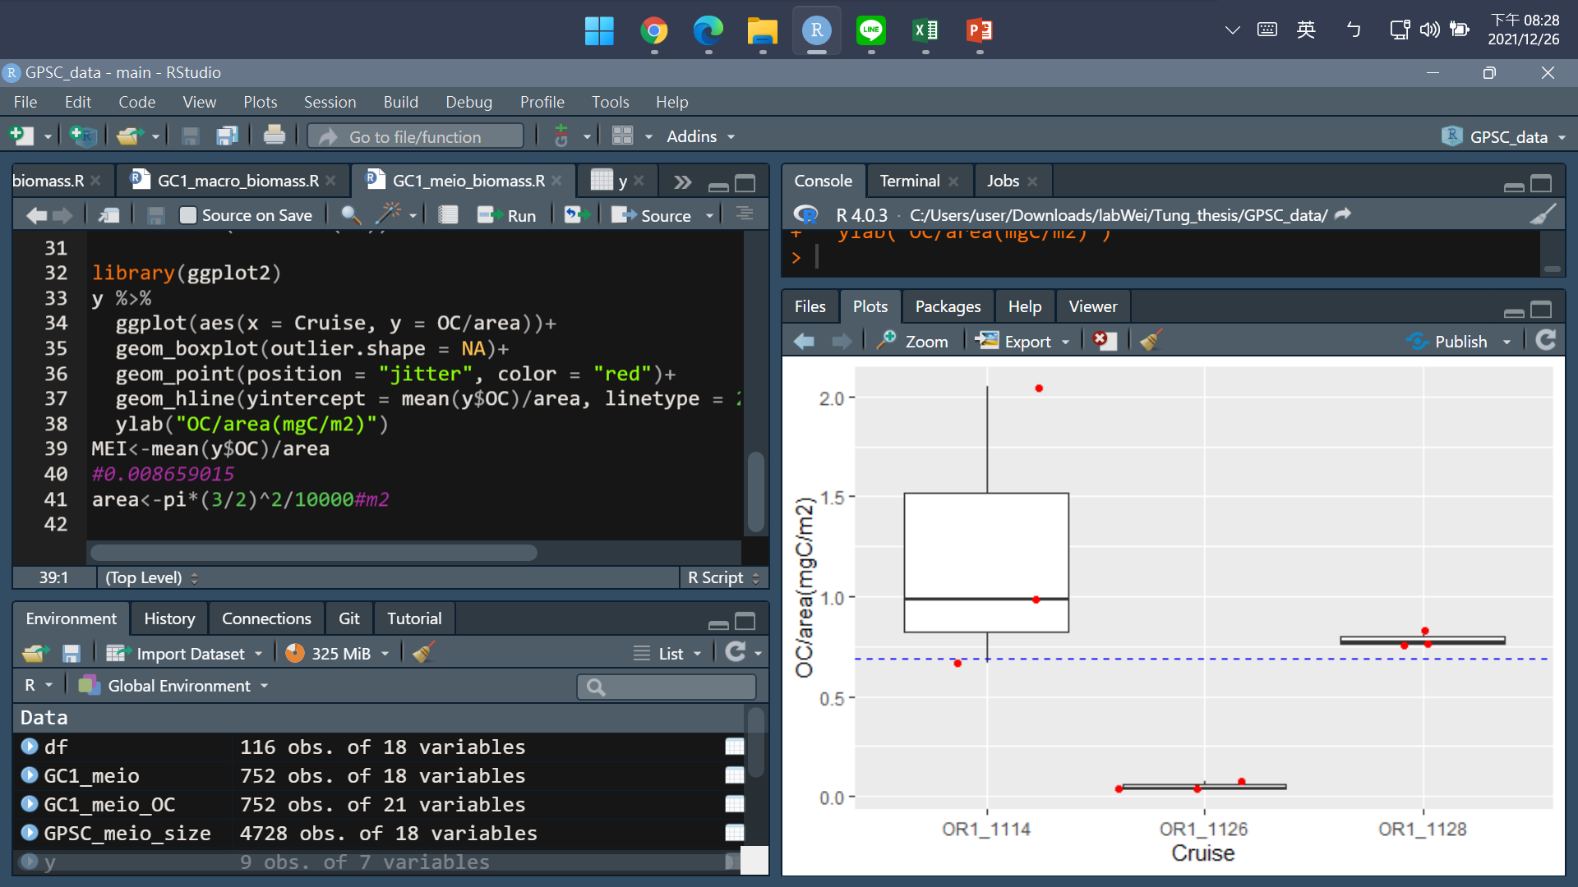
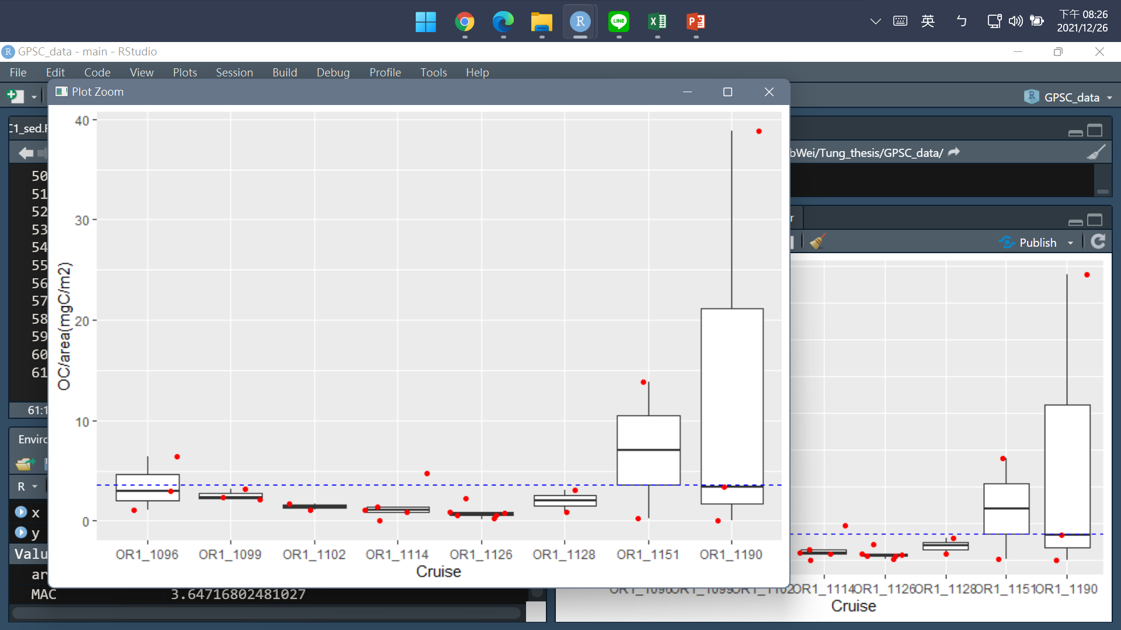
Detritus
Meiofauna
Macrofauna
Problem 3
Should foraminifera be included?

Slide 34
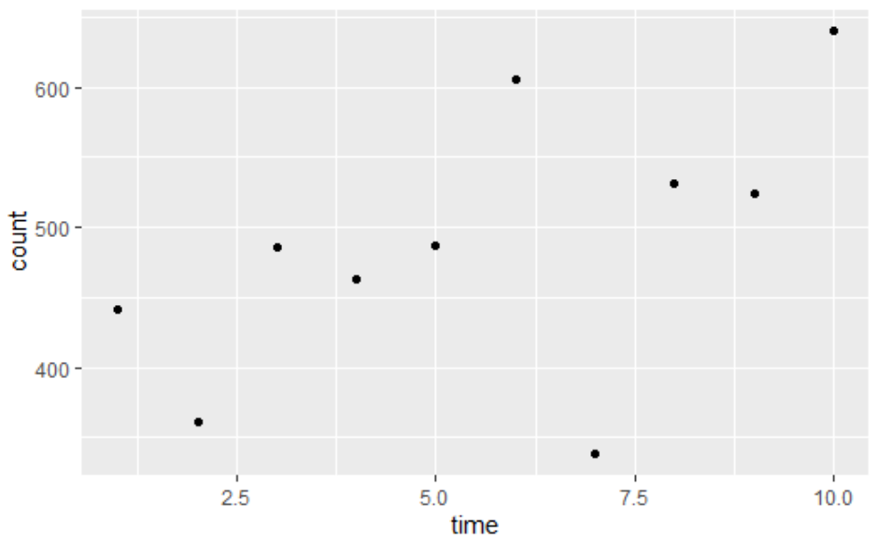
Bacteria
Code:
A<-9^2*pi #well area (mm^2)
a<-0.11^2*pi #view area (mm^2)
V<-0.1/2 #sample volume (ml)
GC1_bac_num <- mean(GC1_bac_count*A/a/V)
#count* A/a/V = # bac/ ml
area<-pi*(3/2)^2/10000#m2
# Convert to biomass (assuming 10 fgC cell-1, Deming & Capenter 2008)
GC1_bac_biomass<-GC1_bac_num*10*V/1E-12/area #fgC/ml*V(ml)/core area(m2)/1E-12=mgC/m2
Problem 2
Vertical sediment depth:
For meio & bac: quantity/syringe area; ignored depth?
For detritus: 0-1 cm
For macro: 0-10 cm

Slide 35
12/27 discussion record
1. Carbon calculation
Sediment: 體積*密度*TOC(%)/core area
Bactieria: #bac/ml(cm3)*(10)cm->換算成m2
Meio/macro: assume all fauna within 5cm/10cm of sediment have been already included (mgC/core(or syringe) area
For macrofauna, carefully remove the outlier
No need: Foraminefera
2. find POC and sedimentation rate (James T.Liu/Chih-An Huh…
3. Seasonal difference
mean model
fall model
spring model
4. figure out respiaration (maybe use 2 models to compare)
measured data
allometric estimation

Slide 36
細分食性:改structure
Assume:
influx POC as a complex assemblage of, while a portion of sediment flows out the system through the process of burial and/or export (orange flows). Then, it is assumed that bacteria feed only on detrital OC; meiofauna feeds on bacteria and detrital OC; macrofauna feeds on meiofauna, bacteria and detrital OC. Then, the meiofauna will be further divided into selective deposit feeders, non-selective deposit feeders, epigrowth feeders, and omnivores/predators (Liao et al., 2020), and the macrofauna stocks will be divided into surface deposit-feeders, deposit-feeders, suspension-feeders, and predators+scavengers (Chen, 2018). Moreover, it is presumed that the predators of each size class prey on organisms of the same and smaller size classes. The grey flows indicate the loss of carbon as the feces and as consumed by benthopelagic/pelagic predators (fig. 12). In this LIM model, the compartments with orange color are part of the food web model, whereas compartments with blue color were only considered as carbon influx or efflux, but were not directly modeled.

